Slide 1
Import substitution policy: a viable strategy or palliative for Russia? lilas Demmou, Annamaria Tuske, Yana Vaziakova and Andreas Wörgötter OECD – economics Department
77th East Jour Fixe of the Oesterreichische Nationalbank
Russia – economic turmoil and policy options
Friday, May 29, 2015
Oesterreichische Nationalbank, Vienna

Slide 2
Import Substitution in Russia A Moving Target
The evidence
A conceptual framework with two drivers
Challenges with econometrics
Framework conditions
Sanctions
The scope for an import substitution policy

Slide 3
The evidence
GDP growth, oil prices and the real exchange rate moved together

Slide 4
Forecasting with a simple growth equation with nothing but oil
lnGDP = 0.19*Brent + 0.0054*trend + CONST
(0.02) (0.0010)
1995q1-2014q3
R2=0.97
The oil price elasticity of earlier estimates is confirmed. Non-oil-price trend-growth is a mediocre 2.1%
With an oil price fall of 50% gdp should therefore fall by 10%, plus 2% trend growth makes for a minus 8% recession in 2015. First forecasts at the beginning of the year were around -6%, now we (OECD) are around -3%
What is happening? Import substitution?

Slide 5
How did imports develop as a share of GDP?
Two episodes with declining imports but opposite gdp dynamics (1998 compared with 2009)

Slide 6
What is import substitution (IS)?
A reduction of imports with an accompanying change of the level of GDP: GDP = C + I + G + X – M
dGDP = dC + dI + dX – dM > 0
A necessary condition for IS to happen is the availability of free resources (labour and capital), the profitability of their employment and an incentive to switch demand from foreign to domestic goods and services

Slide 7
What was the Russian business model
Decline of the share of manufacturing to 12% - Dutch disease in full operation
High growth achieved by expanding services, mainly importing consumer goods (retail trade), real estate and exporting capital (financial sector)

Slide 8
Was this model sustainable?
Only with growing oil prices

Slide 9
Two drivers of import substitution
Dutch disease Russian style – increasing incomes from rising oil prices generate a substitution from low quality domestic goods and services to high-price imported goods and services. This effect is fast moving in both directions, because it takes place on the demand side…[this can take place without policy support]
Relative price changes – imported goods becoming more expensive generate incentives for domestic supply responses. This effect is slow moving and lasting. [This will require structural reforms]

Slide 10
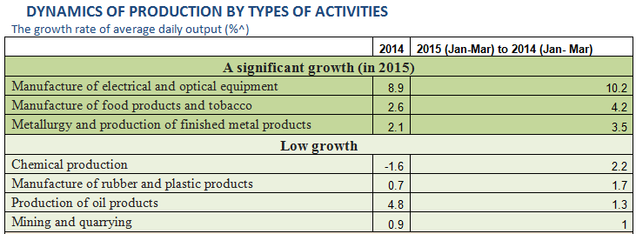
Currently growing sectors

Slide 11
Framework considerations
Demand side responses do not need structural reforms – except maybe concerns about consumer protection.
Supply side responses – underpinned by true import substitution – need business friendly framework conditions.
This is where sanctions are becoming most damaging: Administered import substitution may become more profitable than market driven substitution. Access to government funding is becoming more important than responding to incentives

Slide 12
How to separate between demand side and supply side driven import substitution
On the demand side it is the oil price, which provides more or less income without any change in domestic efforts. Associated revenues should be treated as transfers
On the supply side structural changes are necessary: - increased capacity requires investment - serving new customers may require changing technology

Slide 13
Empirical prerequisites
The demand side effects are captured by the oil price: a low oil price is associated with lower incomes and depreciation, reducing the demand for more expensive imports
The supply side is more difficult to model: The original shock/incentive concerns relative prices - whether this turns into changes of relative profit outlooks depends on the absence of entry barriers - whether these turn into intended action depends on the rule of law - whether these become realised depends on the availability of financing and skilled labour

Slide 14
What are the prospects for import substitution now?
Imports are falling more than incomes and provoked by sanctions
GDP is falling much less than what could be expected after the fall in oil prices
Will the relative price effect become like 1998 (long lasting depreciation, strong gdp growth, slow recovery of imports) or 2008 (short depreciation, weak gdp recovery, strong recovery of imports)
However, sanctions and missing structural reforms may generate compensating obstacles for import substitution

Slide 15
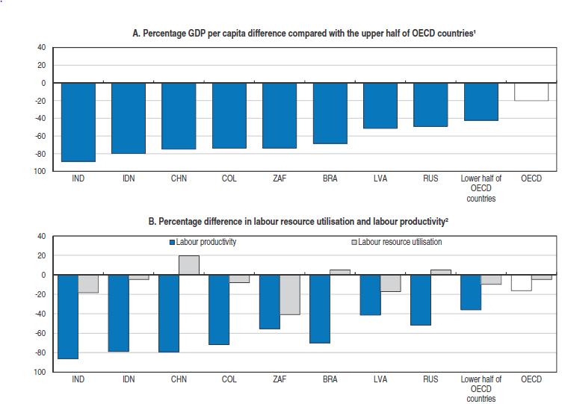
GDP per capita difference decomposed

Slide 16
Where can the resources for import substitution come from?
The labour force is shrinking
Capital is fleeing
Productivity is all what is left
OECD and IMF analysis shows that competition friendly product market regulation is good for productivity and innovation

Slide 17
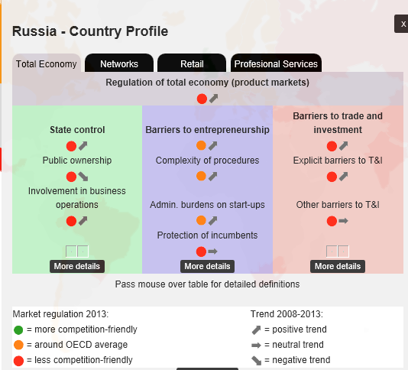
How is PMR developing?

Slide 18
Bottomline
Market driven import substitution can also happen in Russia
But under more difficult circumstances success will depend on structural reforms, which amplify incentives from relative price changes
Given the large distortions and productivity catch-up potential a considerable scope for import substitution could exist

Slide 19
Thank you for your attention
Please provide suggestions and ask questions
e-mail: Andreas.Woergoetter@oecd.org

