Slide 1
Deutschland und sein LBÜ Eine makro-strukturelle Analyse Germany and its CAS – a macro-structural analysis
Andreas Wörgötter
Economica Jour Fixe
Wien, Liniengasse 50-52
Dienstag, 23.05.2017, 09:30 Uhr

Slide 2
Work in progress
Coricelli,F. and A. Wörgötter (2012), "Structural Change and the Current Account: The Case of Germany", OECD Economics Department Working Papers, No. 940, OECD Publishing, Paris. DOI: http://dx.doi.org/10.1787/5k9gsh6tpz0s-en
Coricelli, F., FR Ravasan and A. Wörgötter (2013), “The origins of the German current account surplus: Unbalanced productivity growth and structural change” Discussion Paper No. 9527, Centre for Economic Policy Research, London.
Germany - A Timid Economic Giant? Refugees, Structural Imbalances and Germany's Current Account Surplus
A blog for the Bertelsmann GED Project https://ged-project.de/topics/competitiveness/challenges_in_international_competitiveness/germany-a-timid-economic-giant/
OECD Economic Surveys: Germany

Slide 3
The Motivation
The large German CA Surplus is contributing to macroeconomic imbalances
The usual recommendations (pay higher wages and/or accept a higher public sector deficit) are controversial in Germany and could be seen as fixing the problem by making Germany weaker (less competitive and fiscally sustainable)
Structural reforms, which make the domestic sector more attractive could provide a win-win solution
Finding jobs for the refugees provides one more argument in this respect.

Slide 4
The Paradox …
Germany is perceived as a strong economy and its high current account surplus is commonly interpreted as an indication of competitiveness and worldwide preferences for high-quality German made products.
The labour market is back to full employment.
Fiscal balances are sustainable and well-being indicators signal a high degree of satisfaction by the German population.
In this situation the inflow of young migrants should be perceived as a positive external impulse, which improves the welfare of the incumbent labour force.
However, the rise of new, populist and anti-migration parties as well as the decline of mainstream parties indicate that standard models may not capture all aspects of the current situation in Germany.

Slide 5
… in a Nutshell
Germany’s economic success since unification is due to a combination of domestic policy settings, beneficial external shocks and structural stability
A labour supply shock can be absorbed without structural change either through higher unemployment (at additional fiscal costs) or lower wages (Hartz reforms)
Absorbing refugees through higher unemployment will become even more fiscally demanding or wages have to fall even more

Slide 6
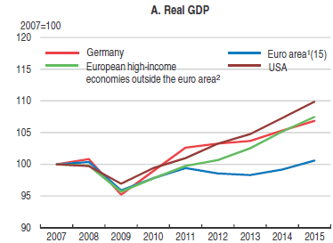
Empirical evidence – crisis and recovery

Slide 7
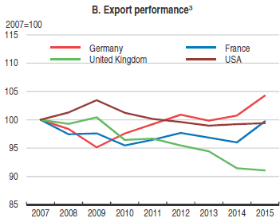
Empirical evidence

Slide 8
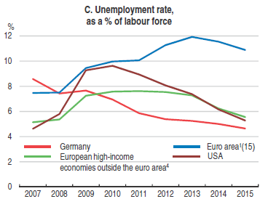
Empirical evidence

Slide 9
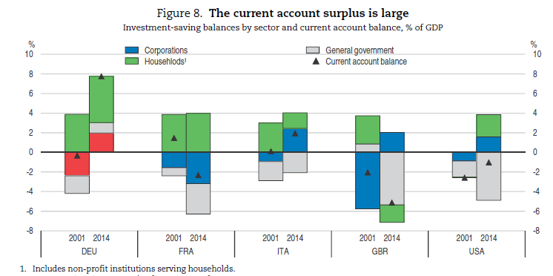
Driving factors behind the current account

Slide 10
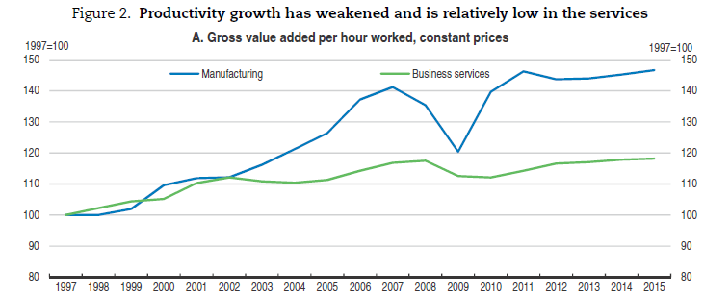
Imbalanced sectoral productivity growth

Slide 11
Policy settings favour incremental innovation
Strict employment protection favours long tenures in house careers
Early specialisation in VET programmes favours employee participation in innovation activities
Grant based innovation support favours existing companies
Bank based enterprise financing favours debtors with a track record and collateral

Slide 12
What happens to Germany after a positive labour supply shock?
Hartz reforms brought about 1 million benefit recipients (about 2 ½ % of the labour force) back into the labour market
Unemployment was increasing together with the increased labour supply
The subsequent decrease of unemployment was achieved through a combination of wage restraint and less hours worked

Slide 13
Unemployment rate

Slide 14
Compensation rate

Slide 15
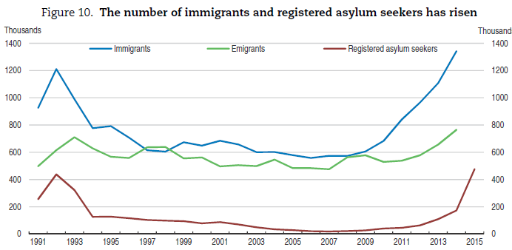
Migrants increase the labour supply about as much as the Hartz reforms

Slide 16
What can the Hartz-reformed low-income workers expect from the refugee wave?
More competition and lower wages above the minimum wage
More competition for active labour market policies if productivity is below the minimum wage
More competition for welfare benefits, like housing allowances, health care services childcare places if dropping out of the labour force
All in all, more stress for the lower segment of the labour market
However, better times for consumers of services provided by low wage workers

Slide 17
Thanks for your comments and questions
Andreas.Woergoetter@tuwien.ac.at

